Slide 1
Flow zoning

Slide 2
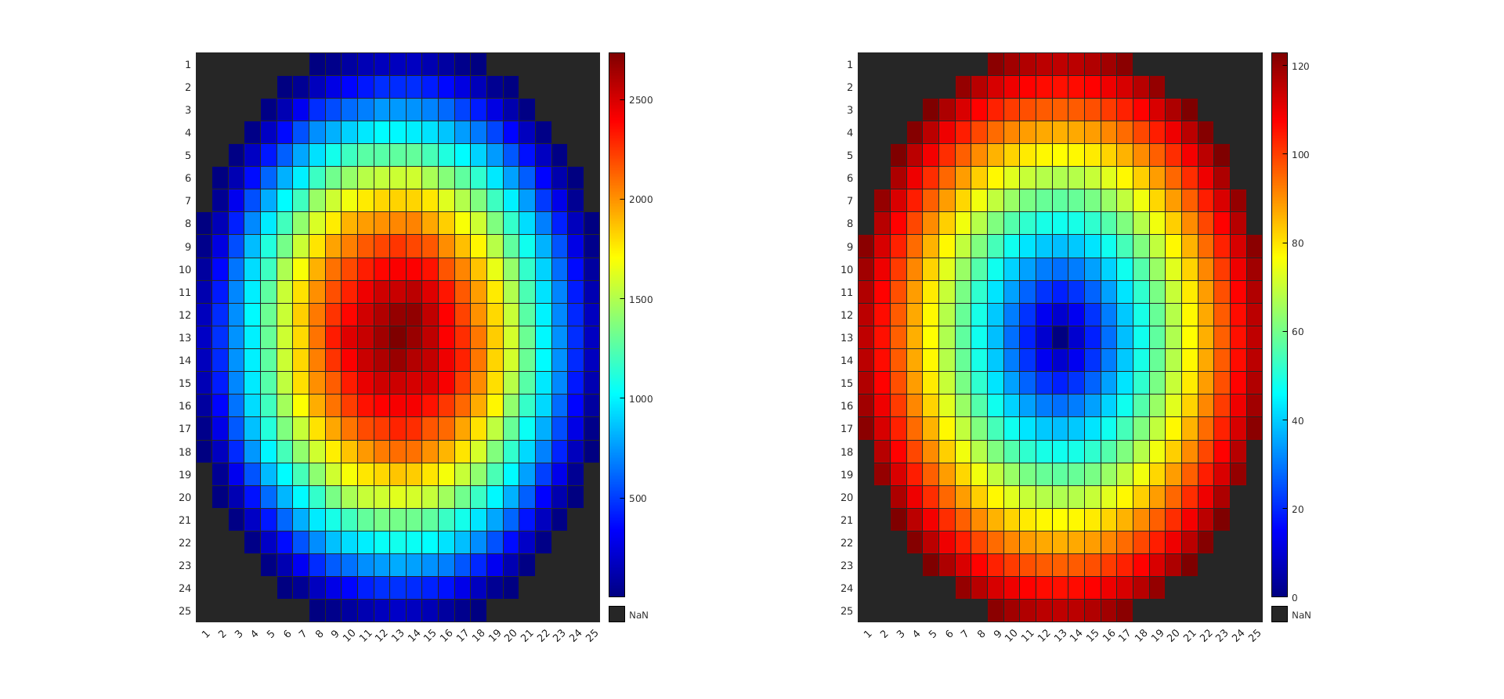

Why radial power distribution:
Flux → proportional to generated fission power (F$lux∗N_{fission}$) → flux tapers radially ( fast leakages) → non-homogeneous power profile.
If the macroscopic fission cross section was increased radially (increase enrichment), the leakages at the periphery would be even higher.
Because of imposed boundary condition, flux will always drop off at the periphery of the reactor.
From my thesis for sodium cooled microreactor

Slide 3
Which phenomena is flow zoning mitigating
Power varies → q = mcpdt → for different power need different coolant flow
Homogenize flow averaged temperature at outlet for all flow channels → maximum outlet temperature
Limit maximum temperatures that fuel, cladding exhibit (this is the most important FoM)
If the flow is close to critical parts that need to have a lower temperature (example: reactor vessel) → increase flow to protect critical structural parts

Slide 4
What factors should be considered:
Power generation per channel
How this changes with BU/ time
What is flow velocity at orifices → cavitation? Thermal striping?
If the power generation changes above the orifice “power levels” → variable orifice should be installed

Slide 5
How is flow zoning done:
goal: vary outlet T radially
To do so: vary flow → vary pressure drop per flow zone
Only solution is to add extra hydraulic resistance to the zones that should have lesser flow
Another impractical solution would be to have individual feeding systems (pumps) for each flow zone.
This resistance can either be constant throughout the lifetime of the reactor, or change as a function of BU.

Slide 6
What if core is shuffled:
If core is shuffled → radial power distribution changes
Either implement flow zoning algorithm described below to optimize for outlet T for core’s lifetime, with constant orifice resistance
Or use variable orifices

Slide 7
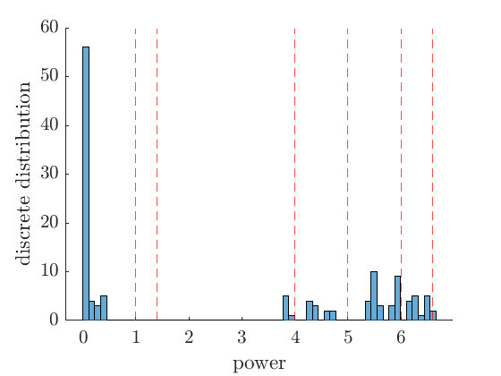
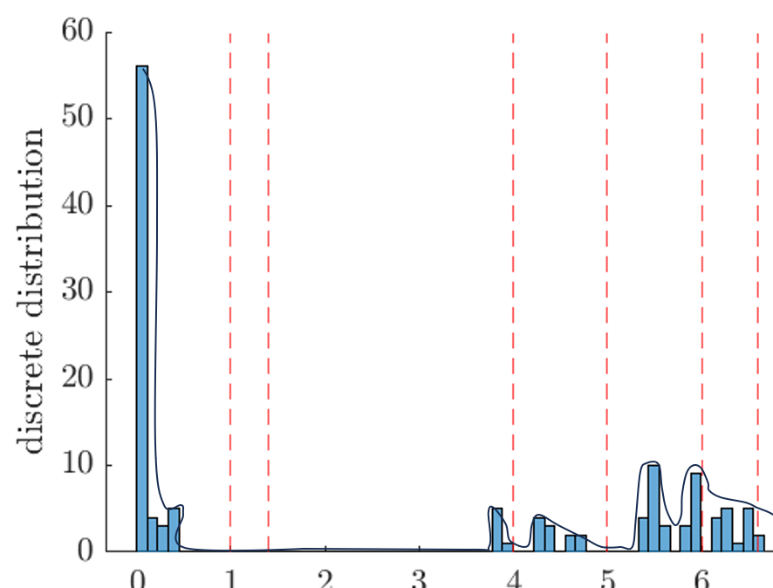
Flow zoning algorithm to maximize outlet temp:
Discrete optimization problem → harder to solve. It could be approximated by using the equivalent “Continuous problem”
Take power values and create histogram:
From discrete distribution function, can analytically approximate its shape:
Now we have an analytical description of the distribution function of the radial power density.
Problem statement: position of cuts is what? So that core averaged outlet T is maximized while fuel T below limits
FoM
Optimization parameters
constraints

Slide 8
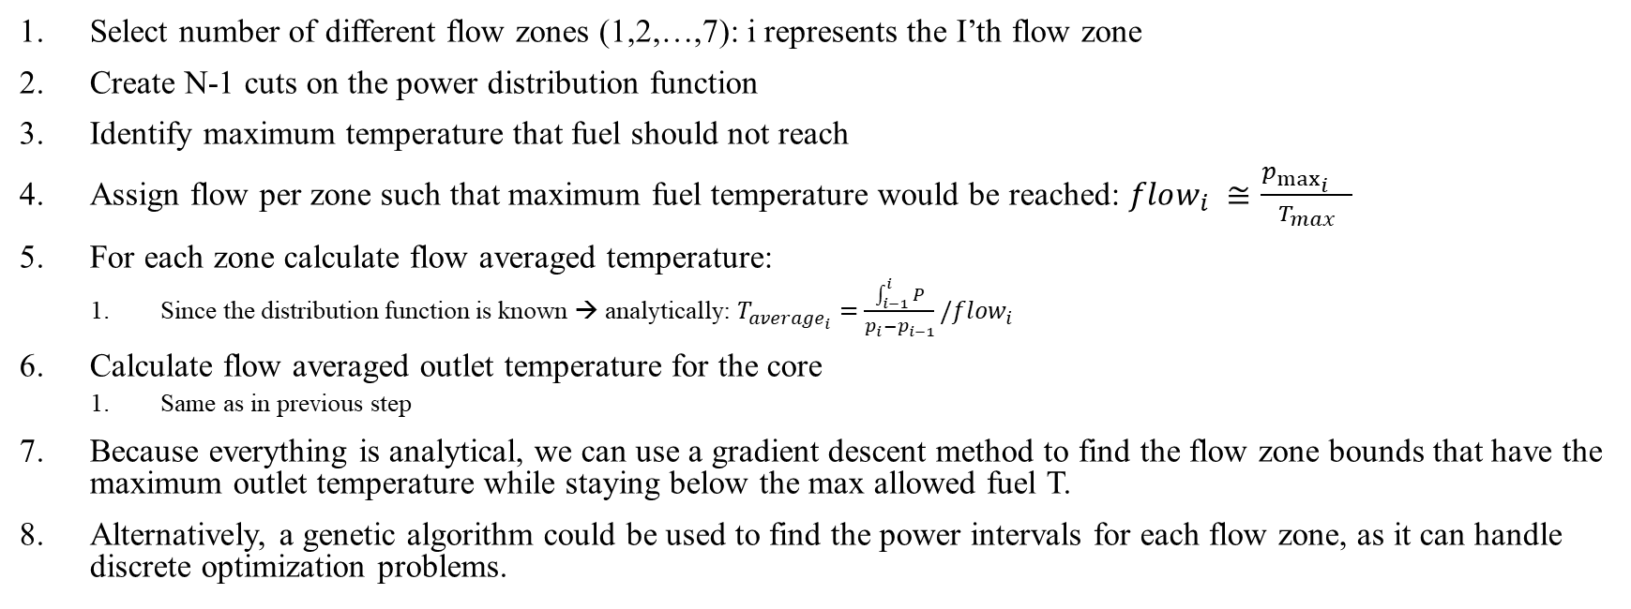
Algorithm continued:
Select number of different flow zones (1,2,…,7): i represents the I’th flow zone
Create N-1 cuts on the power distribution function
Identify maximum temperature that fuel should not reach
Assign flow per zone such that maximum fuel temperature would be reached: $flow_{i} ≅\frac{p_{\max_{i}{}}}{T_{max}}$
For each zone calculate flow averaged temperature:
Since the distribution function is known → analytically: $T_{average_{i}}=\frac{\int_{i−1}^{i}{P}}{p_{i}−p_{i−1}}/flow_{i}$
Calculate flow averaged outlet temperature for the core
Same as in previous step
Because everything is analytical, we can use a gradient descent method to find the flow zone bounds that have the maximum outlet temperature while staying below the max allowed fuel T.
Alternatively, a genetic algorithm could be used to find the power intervals for each flow zone, as it can handle discrete optimization problems.

Slide 9
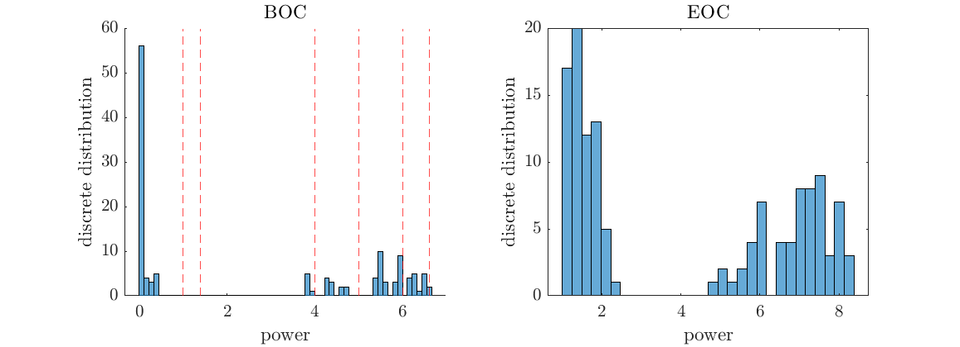
If we have multiple power distribution functions (BOC, EOC, etc.) :
Distribution function for each snap-shot
Conduct same analysis as before, but with common bounds for multiple snap-shots
Average outlet temperature from all snap-shots

